Slide 1
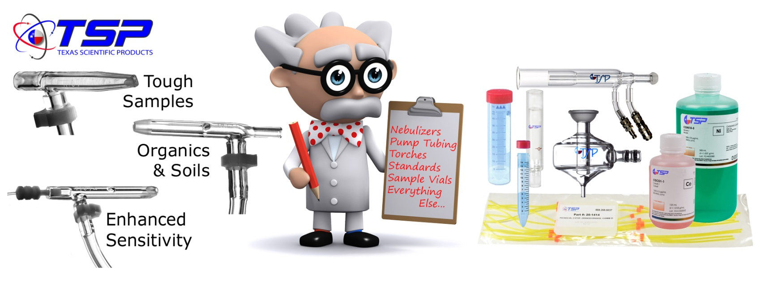
Mid-Atlantic Soil Testing and Plant Analysis Work Group 2023
Embassy Suites by Hilton Raleigh Crabtree
Raleigh, NC

Slide 2
Optimizing Productivity For ICP Analysis of Agronomic Samples
Mike Moses , Texas Scientific Products, LLC

Slide 3
TSP: Your “Go-To” Resource For
“All-Things ICP” & More
Established 2004
Focus ICP/ICP-MS/XRF
Dallas, Texas (Headquarters)
Colorado (Glass Design & Production)
Boston Massachusetts (East Coast Office)
3 Partners, 6 Sales & Logistics, 5 Design & Manufacturing, 2 General & administrative
Dr. Sergei Leikin Product & Business Development
Bruce Moulton Marketing and Operations
Doug Keene Sales Operations
Mike Moses Business Development
Over 100 years experience collectively in ICP/ICP-MS/XRF and Digestion Techniques

Slide 4

Priority Concerns For the High-Production Agronomy Lab:
Speed
Accuracy
Procedural Consistency
  Batch-to-Batch
  Operator-to-Operator
Cost Containment

Slide 5
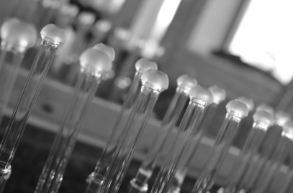
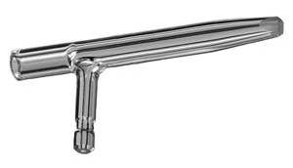
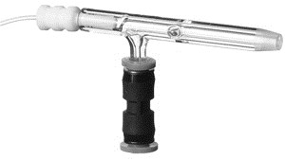
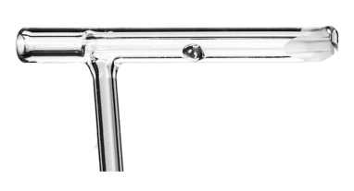
Proprietary High Solids Nebulizers by TSP
Model | Description | Ideal Application
OptiMist® Soil | Non-concentric gas and sample paths; Sample channel ID 0.50mm | Soils
OptiMist XL® | Non-concentric gas and sample paths; Sample channel ID 1.0 – 2.0mm; | Soils, Plant Tissues & Fertilizer Extracts Samples with very large particulates (>1000μm) and/or Up to 30% TDS
OptiMist Vortex® | Non-concentric gas and sample paths; Unique striker plate | Environmental Waters Plant Tissues Low Mo

Slide 6

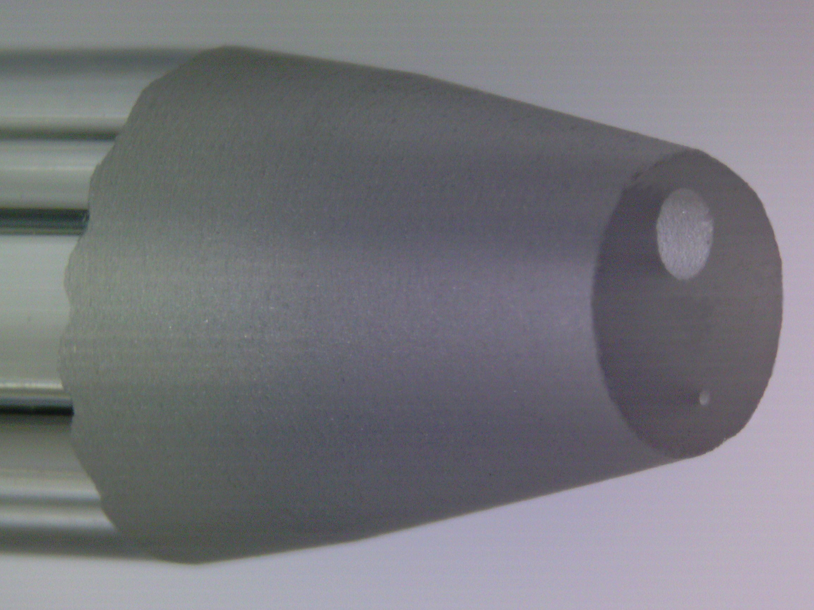
OptiMist® XL - High Solids Nebulizer
Improved Dual Channel (IDC)
Clogging from particles is virtually eliminated.
Extended Life Expectancy
Eliminate sample filtration
LOW Maintenance

Slide 7
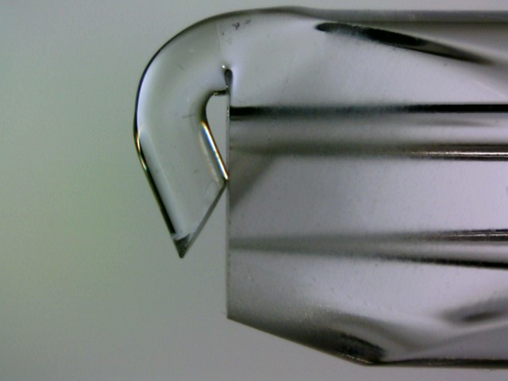
OptiMist Vortex®
Improved Dual Channel (IDC)
Enhanced Efficiency (E2)
Astounding increase in the ICP’s signal-to-background ratio
Best Sensitivity / Detection Limits
High Salt / High Total Dissolved Solids capable
LOW Maintenance

Slide 8
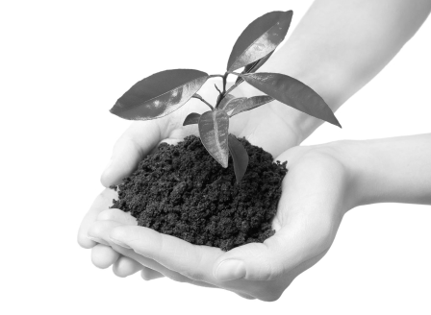
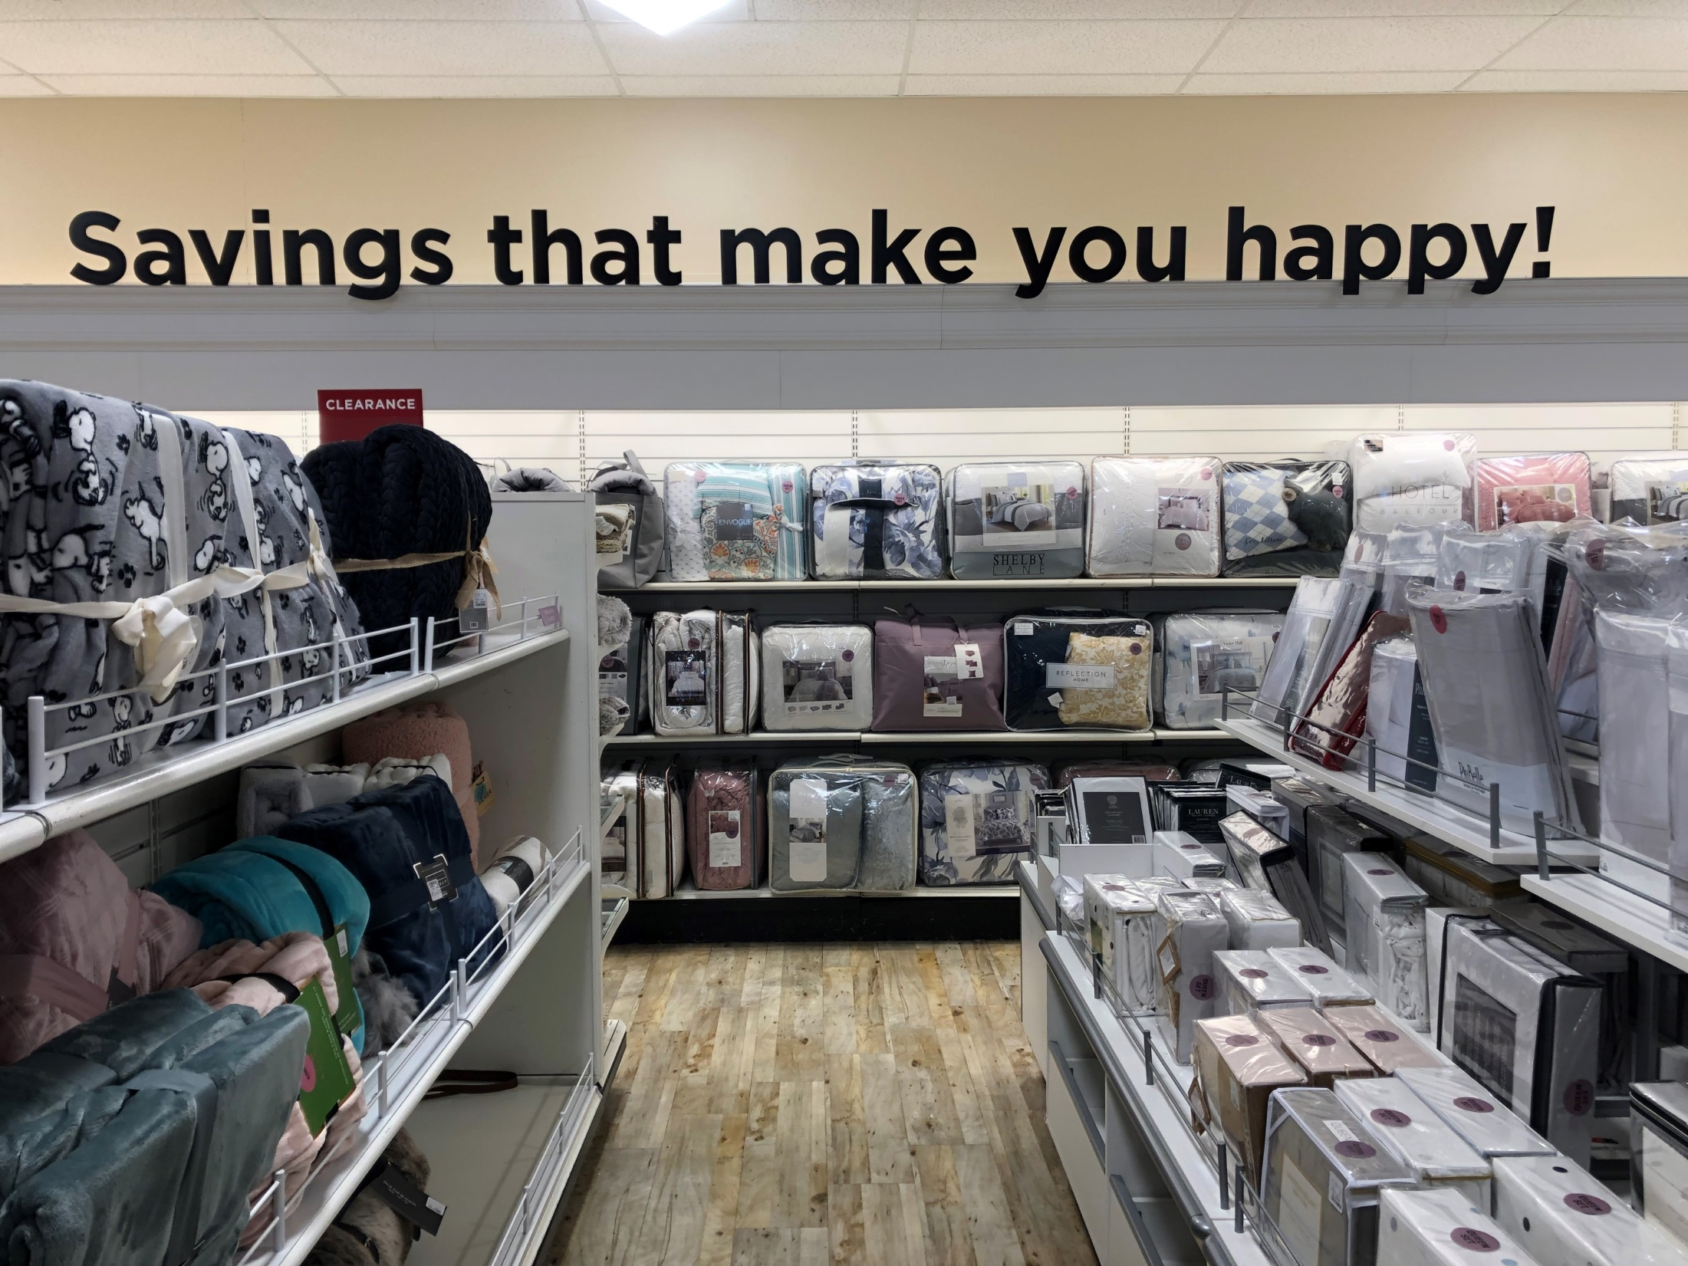
Custom-Made Multi-Element Calibration Standards
Can be manufactured for various sample types, for example:
  Soils
  Plants
  Environmental
Usually made to 10x the highest concentration of each element (to allow for serial dilutions in making calibration curves)
Traditional high cost is mainly labor

Slide 9
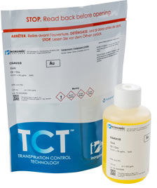
Extended Shelf Life
4 years in TCT (Transpiration Control Technology) Bag (Inorganic Ventures proprietary design)
+1 year - after standard bottle is removed from the bag/opened
=up to 5 years
TOTAL

Slide 10
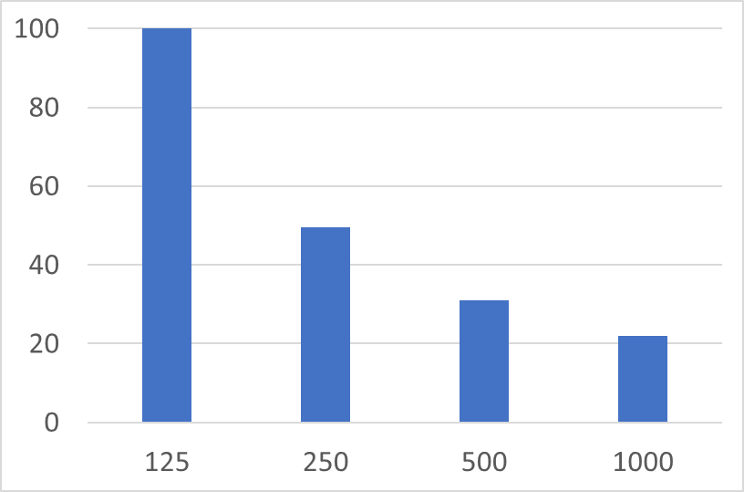
Cost Structure of the ICP-OES Custom Standard
Relative Price
per mL , %
5
Standard Volume, mL

Slide 11

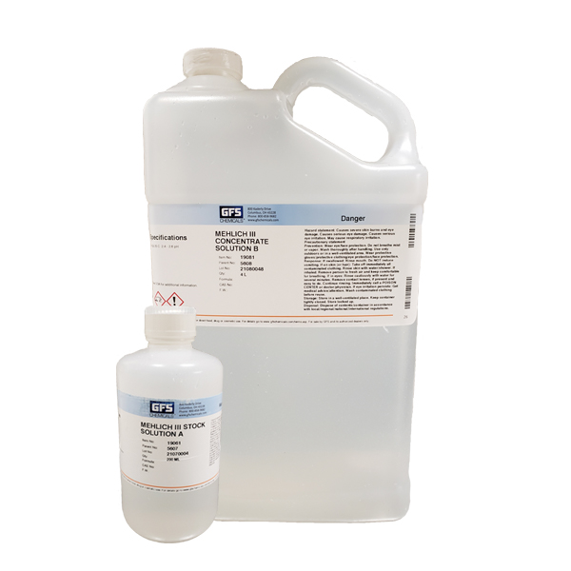

Introducing Mehlich III Extraction Kits
From Texas Scientific Products
Cuts prep from days to minutes
Concentrated Solution A + Solution B mixed together and with D. I. or reverse-Osmosis H₂O to make up to 50 L
Significant reduction of labor costs
Saves $ over mixing from raw chemical ingredients
Saves space
Reduces Shipping Cost
Eliminate contamination issues
Increase consistency from batch to batch
100% satisfaction guarantee
Mehlich III also available pre-made in 20L cubitainers

Slide 12
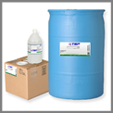
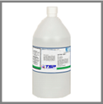
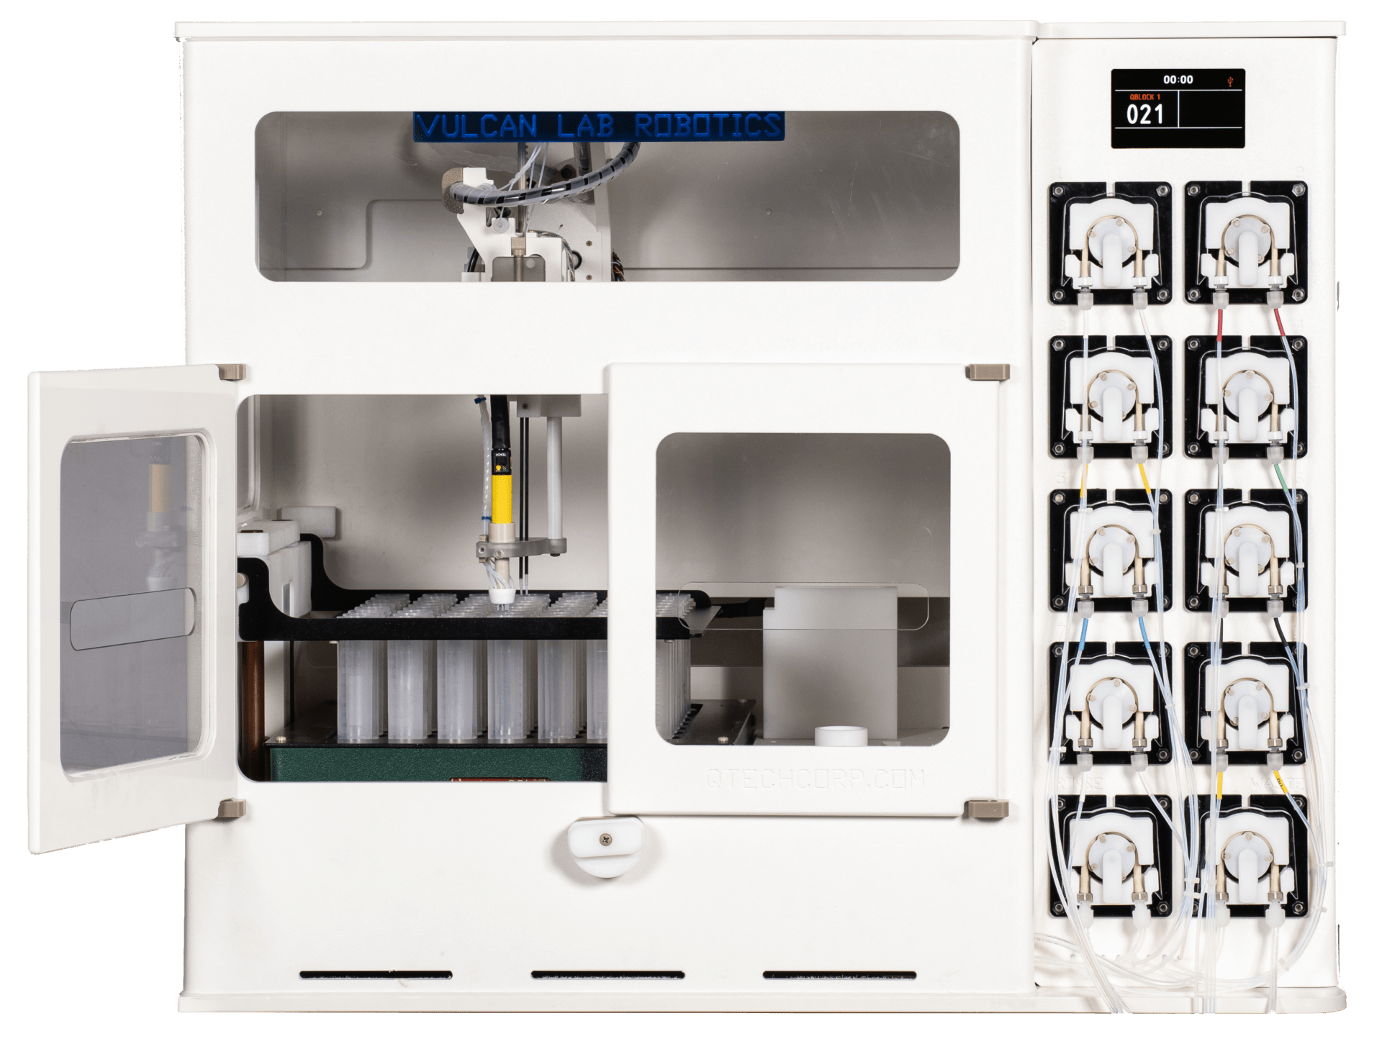
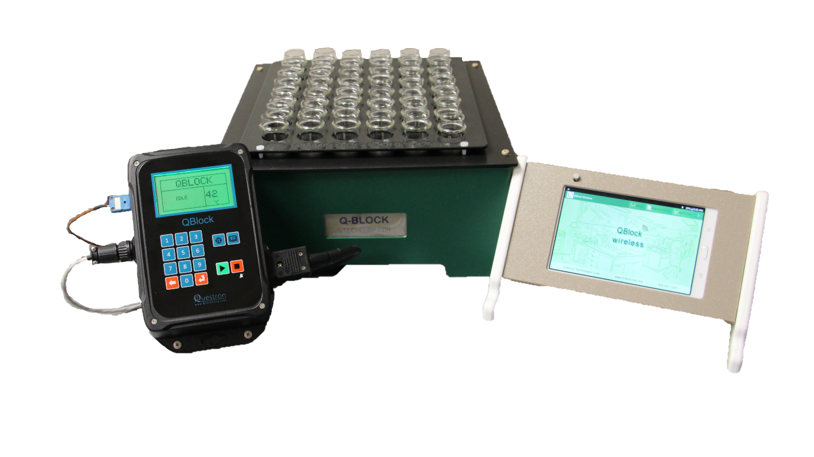
What Else?
pH Buffers, Acids, & Reagents
Pump tubing for ICP and now also for Auto-Analyzers
New Auto-Analyzer reagents and IC standards
Hot Block
Vulcan Automated Digestion System

Slide 13
Coming Attractions…
Research demonstrating Axial ICP-OES can be comparable to ICP-MS for cannabis products testing.
“Big Four” toxic elements (Arsenic, Cadmium, Mercury, and Lead) are currently defined at very low levels by California, Colorado, and Massachusetts; also minors.
ICP-MS is quite complex in operation, has a high cost of ownership, and needs significant routine maintenance.
ICP-OES - when properly configured - is an attractive alternative to ICP-MS.
  Can achieve the necessary sensitivity
  Is simpler to operate
  Less costly to maintain as compared to ICP-MS
  Reaches trace level detection limits while maintaining high productivity / high sample throughput

Slide 14
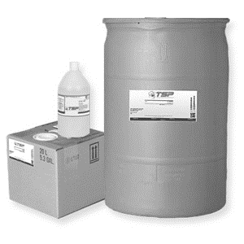
Thank you to:
Dr. Kristin Hicks for carrying on in the footsteps of Dr. David Hardy, and the Plant Tissue, Waste & Compost, Solutions and Soilless Media Testing, NCDA&CS laboratory for all their support, the work done to put on our meeting, and for the opportunity to participate in it!
Dr. Jay Lessl from the Ag & Environmental Services Lab at UGA for coordinating the presentations and meeting agenda.

